Slide 1

Dream Escape Travel
Welcome to the presentation on Dream Escape Travel, a new tour and travel agency dedicated to providing unforgettable experiences.

Slide 2
Introduction
Dream Escape Travel
Personalized Journeys
Dream Escape Travel aims to create seamless and unforgettable travel experiences for all our clients.
We prioritize personalized itineraries that cater to individual preferences and budget, ensuring a unique adventure.

Slide 3

Problem Definition
Travel Complexity
Time Constraints
Travel planning can be overwhelming, with countless choices and decisions to make.
Busy lifestyles often leave little time for extensive travel planning and research.
Budget Limitations
Financial constraints can hinder individuals from realizing their dream travel plans.

Slide 4

Objectives
1
Simplify Travel Planning
2
Offer Customized Itineraries
Provide a user-friendly platform for easy travel planning and booking.
Create personalized itineraries that cater to individual needs and interests.
3
Enhance Travel Experience
Deliver exceptional customer service and memorable travel experiences.

Slide 5

Methodology
Market Research
Partner Collaboration
Thorough analysis of travel trends, popular destinations, and customer preferences.
Strategic partnerships with hotels, airlines, and local tour operators to offer competitive pricing and services.
1
2
3
Technology Development
Implementation of a user-friendly platform for booking, itinerary management, and customer support.

Slide 6
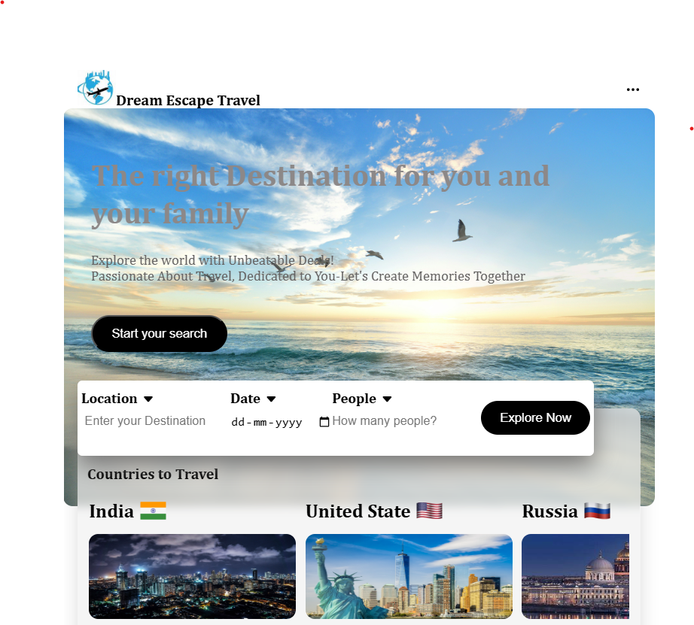
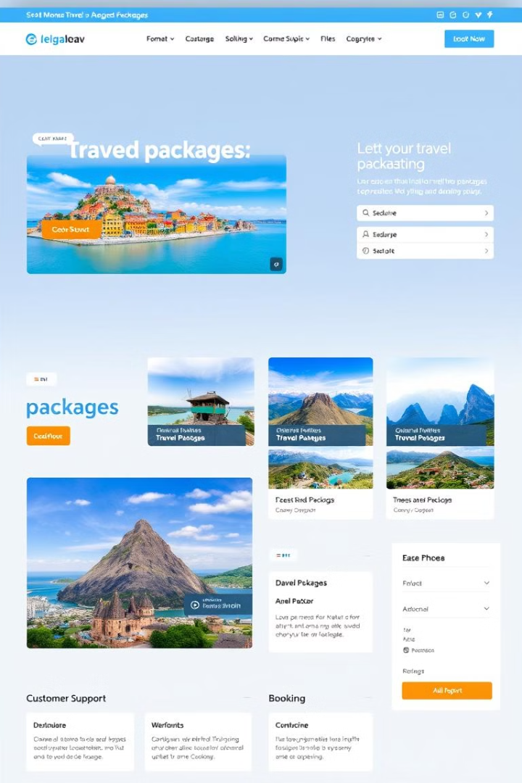



Modules
Destination Pages
Detailed information on various destinations, including attractions, activities, and accommodation options.
Itinerary Builder
A customizable itinerary builder that allows users to select their desired destinations, activities, and travel dates.
Customer Support
24/7 customer support for assistance with booking, itinerary modifications, and travel-related inquiries.

Slide 7





Application/Advantages
Convenient Booking
Effortless online booking process, accessible from anywhere, at any time.
Personalized Itineraries
Tailored itineraries based on individual interests, budgets, and travel styles.
Expert Guidance
Access to experienced travel professionals for assistance with planning and booking.
Competitive Pricing
Negotiated rates with partners for competitive pricing on flights, hotels, and tours.

Slide 8
Limitations
Limited Availability
1
Availability of specific travel packages and destinations may vary.
Technical Issues
2
Potential for technical glitches or website outages.
Customer Feedback
3
Reliance on user reviews and feedback for destination information and recommendations.

Slide 9

References
1
2
3
Travel Trends
Industry Reports
Customer Feedback
Recent research on travel trends and consumer preferences.
Industry reports and analysis from travel agencies and tourism organizations.
Reviews and feedback from previous clients on our services.

